Slide 1

NPTEL
Applied Accelerated Artificial Intelligence
Instructor: Dr. Satyajit Das
Dept. of Computer Science and Engineering
Indian Institute of Technology Guwahati, Assam, India

Slide 2
Segment 4: Interconnects - PCIe, NVLink and NVSwitch
The communication fabric that determines whether your multi-GPU cluster runs or crawls

Slide 3
Learning Objectives - Segment 4
01
Describe PCIe lane architecture and calculate peak bandwidth for Gen 4 and Gen 5
02
Explain why NVLink was invented and quantify its bandwidth advantage over PCIe
03
Understand NVSwitch as an all-to-all crossbar enabling full-mesh GPU communication
04
Identify the communication primitives used in distributed training (AllReduce, AllGather, ReduceScatter)
05
Apply the concept of communication-compute overlap to analyse distributed training efficiency

Slide 4
PCIe: The Universal Interconnect
PCIe Architecture Fundamentals
Point-to-point serial link: lanes carry 1 bit/direction simultaneously
x16 slot: 16 differential pairs transmit/16 receive = 32 wire pairs total
Physical: 8b/10b (Gen1-2) or 128b/130b encoding (Gen3-5) for DC balance
PCIe Bandwidth Progression
PCIe 3.0 x16: 16 GB/s per direction (2017-era GPUs)
PCIe 4.0 x16: 32 GB/s per direction (A100, 2020)
PCIe 5.0 x16: 64 GB/s per direction (H100 PCIe, 2022)
PCIe 6.0 (2023): 128 GB/s per direction with PAM-4 signalling
PCIe Topology in AI Servers
Root Complex (CPU) connects to PCIe switches downstream
Multiple GPUs share switch uplink bandwidth - contention at scale
PCIe peer-to-peer (P2P): GPU-GPU direct without CPU involvement (same switch)
PCIe Bandwidth vs AI Demand
PCIe 5.0 x16: 64 GB/s
H100 HBM3: 3350 GB/s (52x faster!)
AllReduce (8 GPUs, 7B model FP16):
Data volume = 2 x (N-1)/N x params x 2 bytes
~ 2 x 7/8 x 7B x 2 = 24.5 GB
At 64 GB/s: ~380 ms (PCIe) vs ~20 ms (NVLink)
Ref: PCI-SIG PCIe 5.0 Specification (2019); NVIDIA GPUDirect RDMA documentation

Slide 5
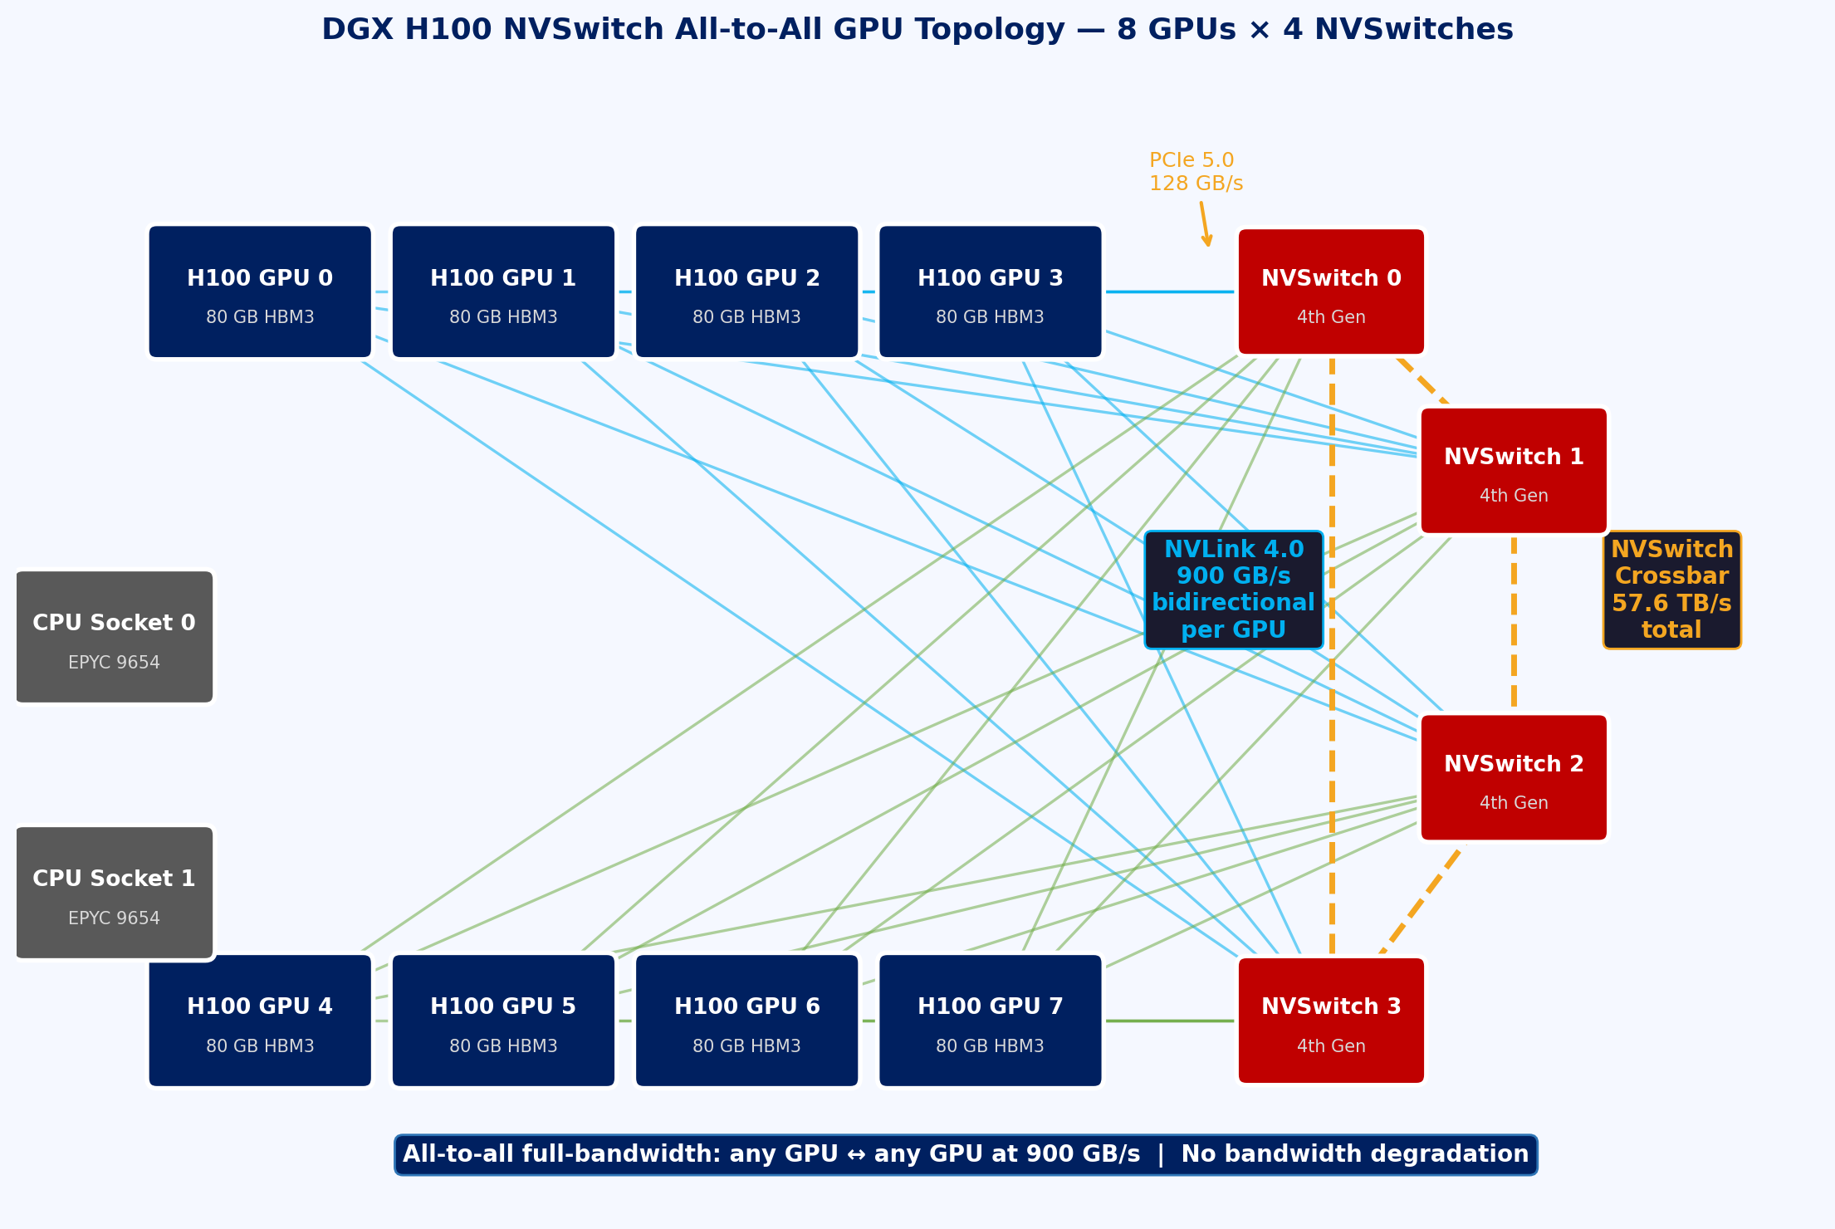
NVLink and NVSwitch: NVIDIA’s High-Bandwidth Interconnect Fabric
Why NVLink? The Problem With PCIe at Scale
PCIe 4.0: 32 GB/s bidirectional - insufficient for gradient AllReduce in large model training
NVLink 1.0 (2016, P100): 160 GB/s bidirectional - 5x PCIe 3.0 immediately
NVLink 4.0 (2022, H100): 900 GB/s bidirectional per GPU - 28x PCIe 4.0
NVLink Technical Architecture
Each NVLink 4.0 link: 25 GB/s x 18 links x 2 directions = 900 GB/s per H100 SXM
Differential signal pairs, low latency (<1 us), coherent cache-line transfers
Directly accesses remote GPU HBM as if it were local memory (NUMA-aware)
NVSwitch: From Point-to-Point to Full Mesh
NVSwitch chip (4th Gen): 57.6 TB/s total switching bandwidth, 256 NVLink ports
DGX H100: 8 GPUs connected via 4 NVSwitches in all-to-all fat-tree topology
Any GPU to any other GPU: 900 GB/s - no bandwidth degradation regardless of pair
NVLink Network: extends NVSwitch fabric across nodes via NVLink switches (NVS 3)
Fig 11: DGX H100 NVSwitch All-to-All GPU Topology
Ref: NVIDIA NVLink and NVSwitch Whitepaper (2023); NVIDIA DGX H100 Systems Architecture (2023)

Slide 6
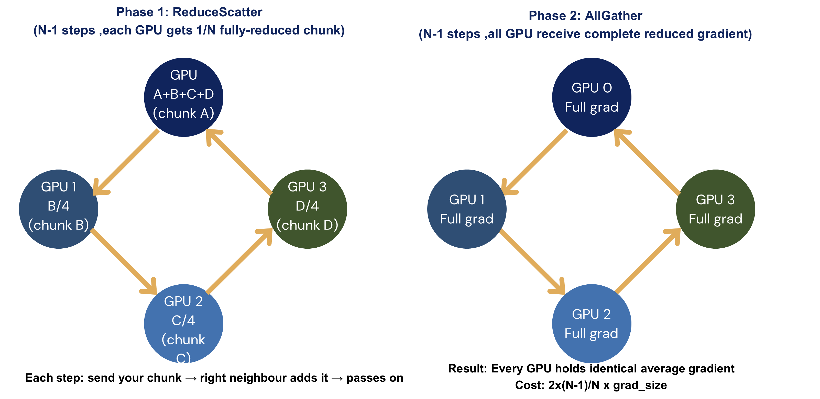
Collective Communication Primitives in Distributed Training
Core Collectives (NCCL Library)
AllReduce: sum gradients across all GPUs, every GPU gets the full result
ReduceScatter: partial reduce + scatter - each GPU gets 1/N of the reduced tensor
AllGather: each GPU collects pieces from all GPUs to form complete tensor
Broadcast: one GPU sends data to all others (e.g., model init, checkpoint load)
Ring AllReduce Algorithm
Divide gradient tensor into N chunks (N = GPU count)
Phase 1 (ReduceScatter): N-1 steps, each GPU accumulates its chunk
Phase 2 (AllGather): N-1 steps, broadcast accumulated chunks to all GPUs
Total data per GPU: 2 x (N-1)/N x grad_size - near-optimal bandwidth utilisation
NCCL vs MPI vs Gloo
NCCL (NVIDIA): GPU-native, uses NVLink/RDMA, best performance on NVIDIA HW
MPI (OpenMPI): CPU-based, used in HPC, supports heterogeneous clusters
Gloo: CPU fallback in PyTorch DDP, used for CPU-only or debug environments
Fig 12: Ring AllReduce — Bandwidth-Optimal Gradient Sync
Ref: Patarasuk & Yuan, “Bandwidth Optimal AllReduce,” 2009; PyTorch DDP Paper, VLDB 2020

Slide 7
Network Topologies for Multi-Node AI Clusters
Fat-Tree Topology (Standard Data Centre)
3-tier Clos: ToR (Top of Rack) - Aggregation - Core switches
Full bisection bandwidth: any-to-any GPU communication at full line rate
Oversubscription ratio (2:1, 4:1) reduces cost but creates congestion at scale
Rail-Optimised Topology (NVIDIA Quantum-2 InfiniBand)
Each GPU connected to different spine switch; intra-node uses NVSwitch
Inter-node traffic spreads across multiple spine paths (load balancing)
NVIDIA Quantum-2: 400 Gb/s InfiniBand, 7,500 ports per fabric, <100 ns latency
Torus Networks (Google TPU, Frontier Supercomputer)
3D/4D torus: nodes arranged in multi-dimensional grid with wrap-around edges
TPU v4 Pod: 4096 chips in 3D torus - excellent for collective operations
AMD EPYC Frontier: 3D torus Slingshot-11 network, 200 Gb/s per node port
Choosing Interconnect for Your Cluster
Single-node 8-GPU: NVSwitch topology is sufficient for most training jobs
Multi-node <64 GPUs: 200 Gb/s InfiniBand or RoCEv2 with RDMA
HPC-scale (>1000 GPUs): InfiniBand HDR/NDR or proprietary (NVLink Network, Slingshot)
Benchmark: nccl-tests --op allreduce --minbytes 1M --maxbytes 16G to measure effective BW
Ref: Besta et al., “Demystifying the MLPerf Training Benchmark,” 2023; Top500.org Frontier System Profile

Slide 8
Segment 4 Summary: Interconnects - PCIe, NVLink & NVSwitch
PCIe 5.0 x16 provides 64 GB/s bidirectional - sufficient for single-GPU but a bottleneck for multi-GPU AllReduce
NVLink 4.0 delivers 900 GB/s per H100, with NVSwitch enabling full-mesh all-to-all at full bandwidth for 8-GPU nodes
Ring AllReduce is bandwidth-optimal: 2(N-1)/N x gradient_size per GPU regardless of ring size
NCCL with GPUDirect RDMA overlaps inter-node communication with backward computation via CUDA streams
Cluster topology (fat-tree, rail-optimised, torus) determines scalability - always benchmark with nccl-tests before optimising

Slide 9
Thank you!

